Slide 1
Mutual Funds & Cryptocurrency Portfolio Analysis

Slide 2
Project Summary
The project aims at building a comparative analysis of mutual funds vs cryptocurrencies. The results of the analysis were then used to build an automated investment advisor based on risk appetite
Mutual funds included in analysis:
Vanguard Target Retirement Funds 2040 & SP 500
Fidelity Target Retirement Funds 2040 & SP 500
T Rowe Target Retirement Funds 2040 & SP 500
Schwab Target Retirement Funds 2040 & SP 500
Cryptocurrencies included in analysis:
Bitcoin (BTC)
Litecoin (LTC
Ripple (XRP
Ethereum (ETH)
Maker (MKR)
Chainlink (LINK)

Slide 3
Risk Level’s
Conservative - 70% Mutual Funds 30% Cryptos
Moderate - 60% Mutual Funds 40% Cryptos
Aggressive - 25% Mutual Funds 75% Cryptos

Slide 4

Robo-Advisor

Slide 5
Metrics for Comparison
Average Annualized Returns
Sharpe Ratio
Sortino Ratio
R2 Ratio
Alpha Ratio
Beta Ratio
Standard Deviation

Slide 6
Mutual Fund - Vanguard

Slide 7
Why Vanguard S&P 500
Why Vanguard Target Retirement fund 2040
Low cost mutual funds - has the lowest average expense ratio 0.09% compared to Industry average expense ratio 0.54%
No Trading Commission when you buy and sell Vanguard mutual funds
Low Brokerage while investing in individual stocks, bonds, or CDs (certificates of deposit) or in other companies' mutual funds.
No Account Services fees , as long as you keep investing at Vanguard
Introduced the first index funds for individual investors
They start with an allocation favoring stocks in the early years of an investor's life cycle, typically 90% stocks and 10% bonds.
Vanguard target-date funds come with an average expense ratio of 0.10%. The industry average expense ratio for comparable target-date funds is 0.60%
Tend to focus more on higher-quality bonds and Treasury inflation-protected securities (TIPS)compared to other fund families.This approach provides better protection of capital against volatility and real value erosion.
Domestic equity holdings of this fund are broadly diversified across the entire U.S. equity market

Slide 8
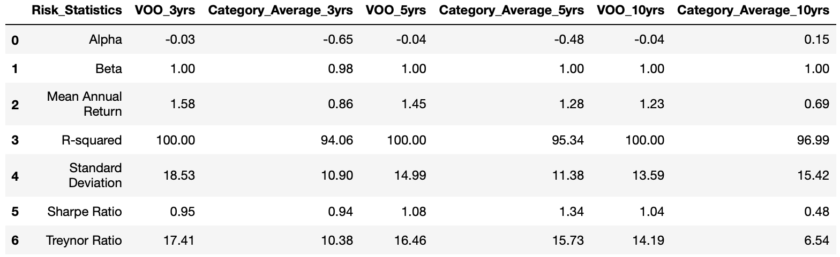
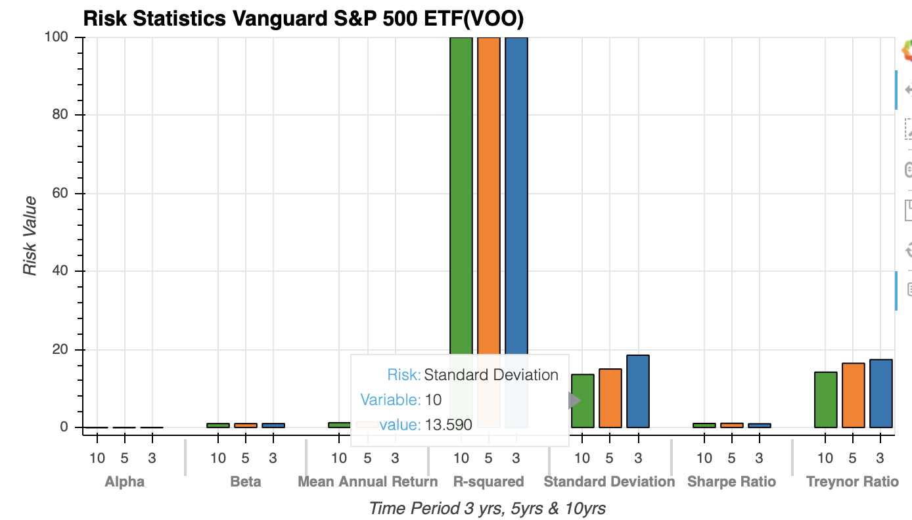
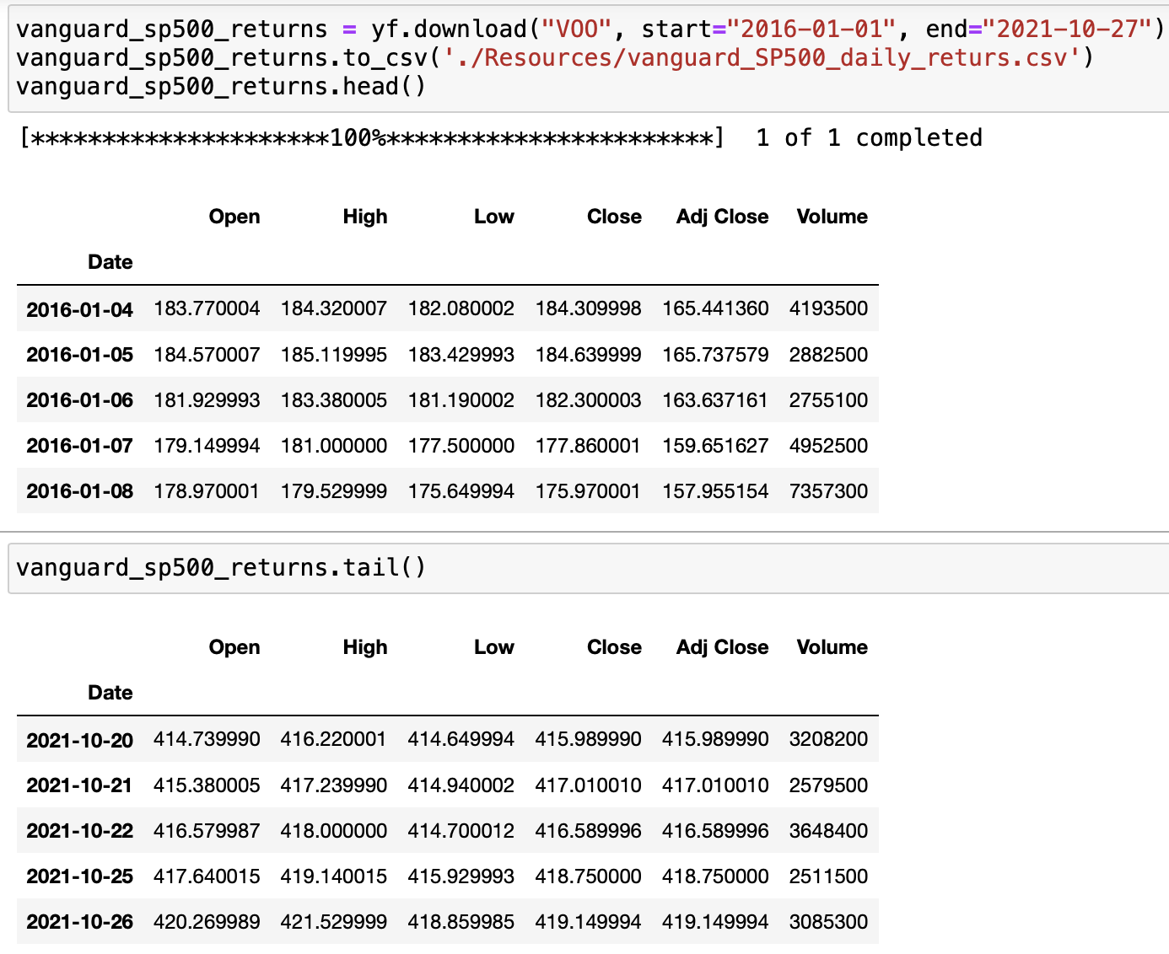
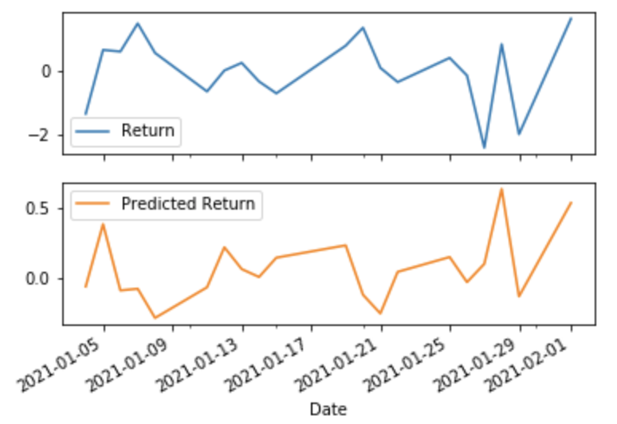
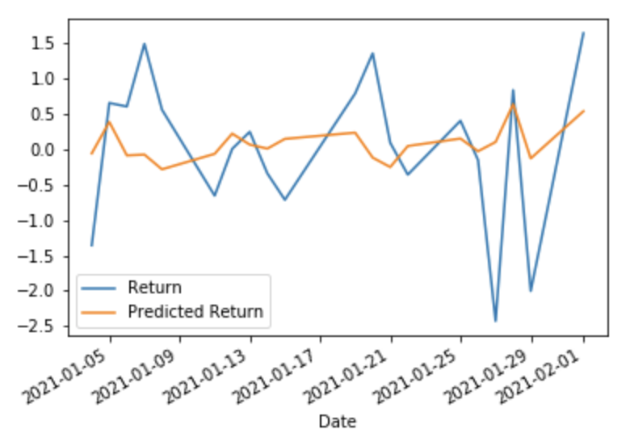
Vanguard SP500 (VOO)
ofs- (RMSE): 0.8024
IS- (RMSE)
1.1758

Slide 9
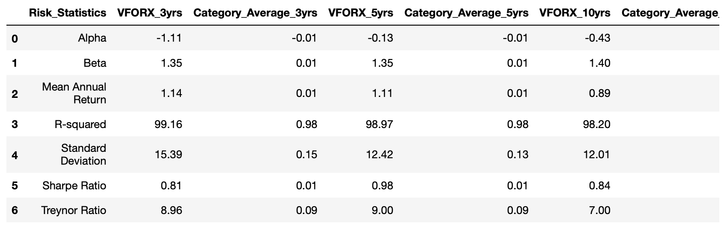
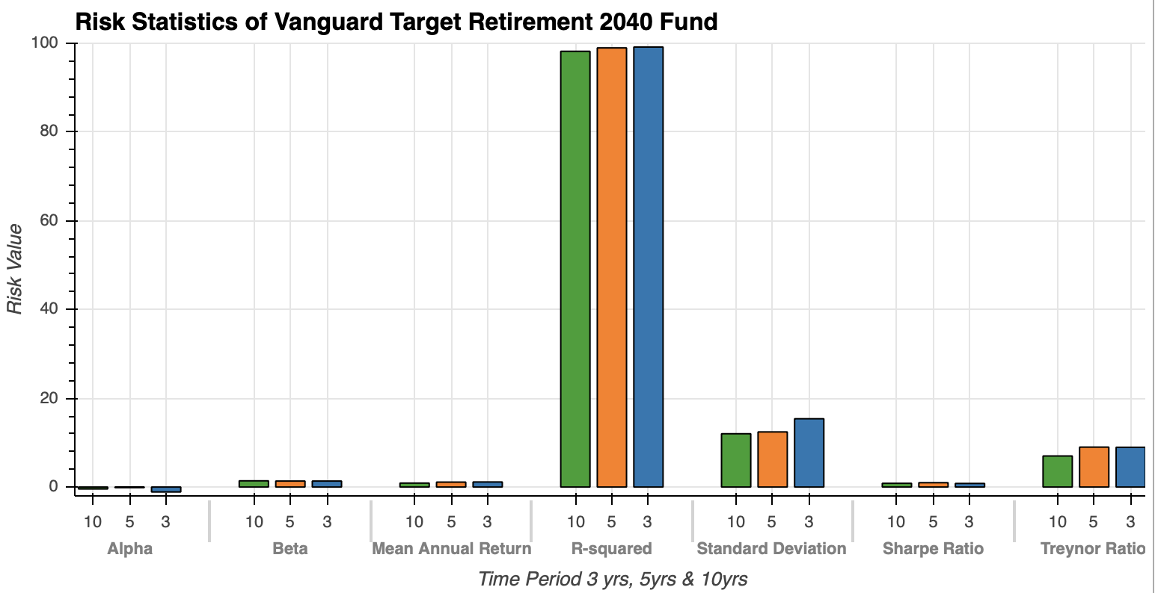
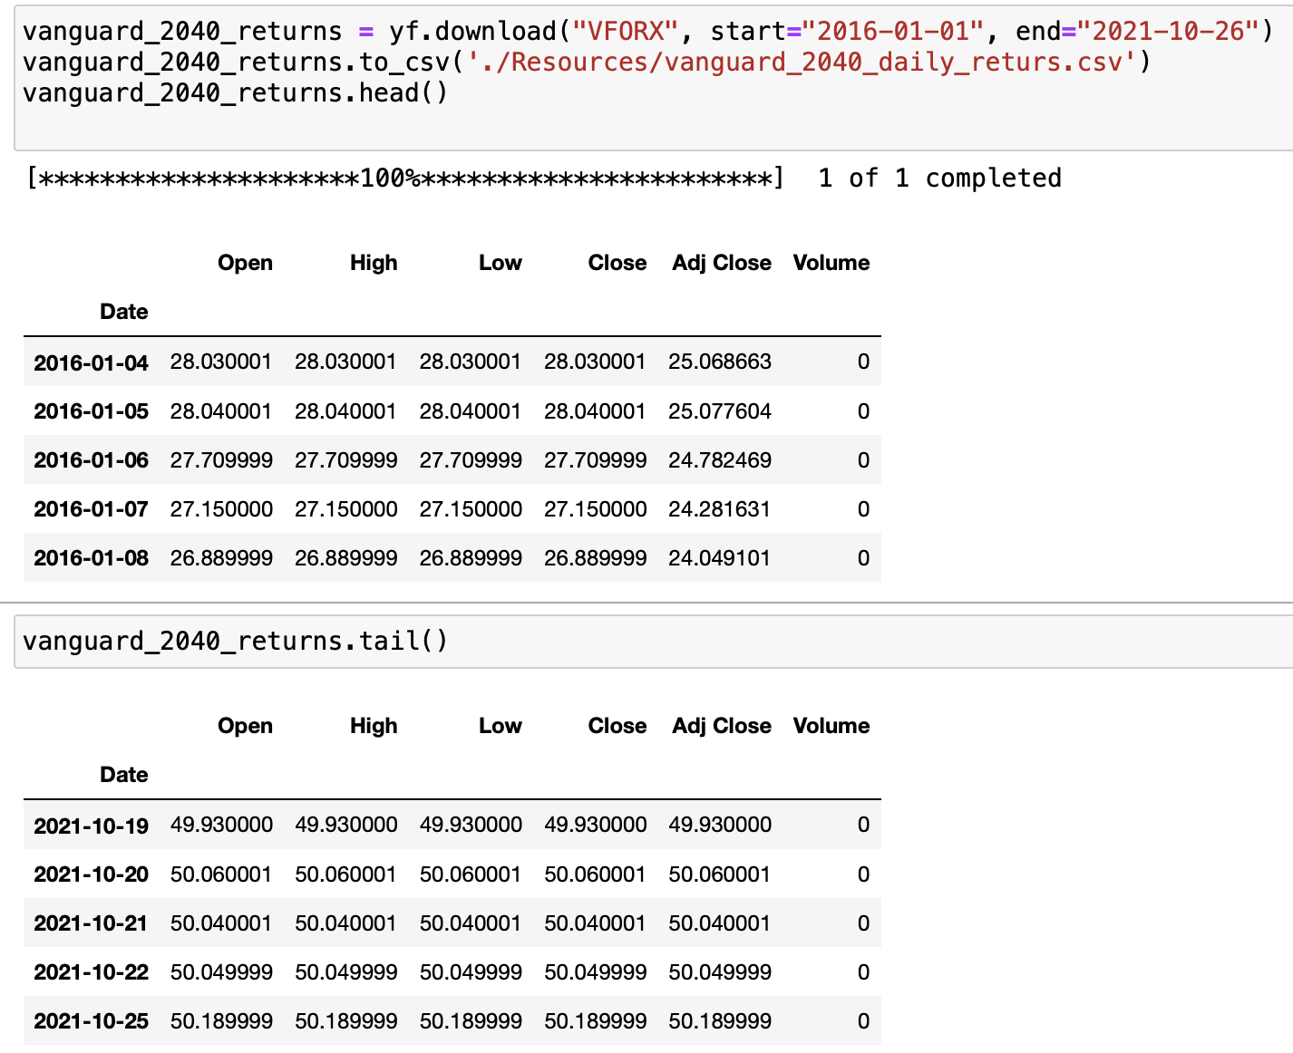
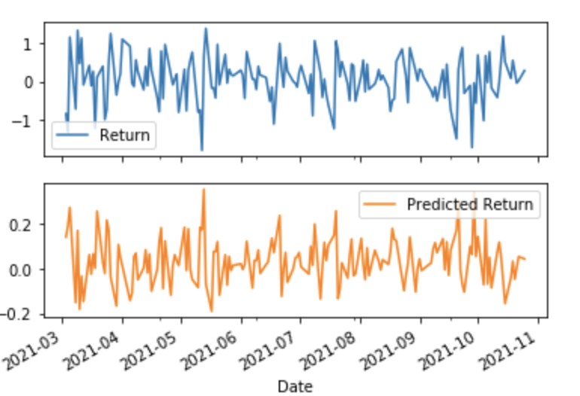
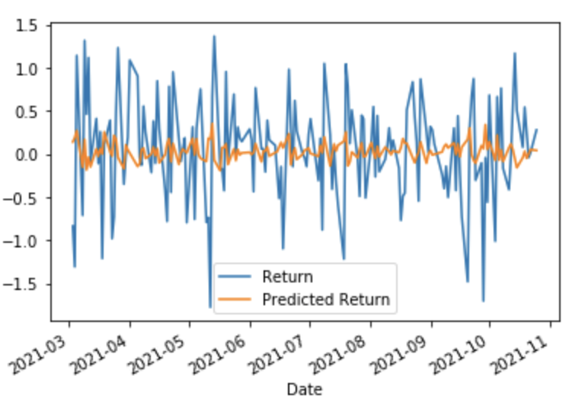
Vanguard Target Retirement 2040(VFORX)
o-f-s (RMSE): 0.6386
I-S (RMSE)
0.9400
Notes:
Out of sample RMSE calculated based on Y train prediction data
In sample RMSE calculated based on X train data
Alpha Ratio : Alpha (α) , used in finance as a measure of performance, is the excess return of an investment relative to the return of a benchmark index
Sharpe ratio: It is defined as the difference between the returns of the investment and the risk-free return, divided by the standard deviation of the investment (i.e., its volatility).
R-squared measures how closely the performance of an asset can be attributed to the performance of a selected benchmark index. R-squared is measured on a scale between 0 and 100; the higher the R-squared number, the more correlated the asset is to its benchmark
Beta of a mutual fund scheme is the volatility of the scheme relative to its market benchmark. If beta of a scheme is more than 1, then scheme is more volatile than its benchmark. If beta is less than 1, then the scheme is less volatile than the benchmark.
the standard deviation is a measure of the amount of variation or dispersion of a set of values.^{[1]} A low standard deviation indicates that the values tend to be close to the mean (also called the expected value) of the set, while a high standard deviation indicates that the values are spread out over a wider range.

Slide 10
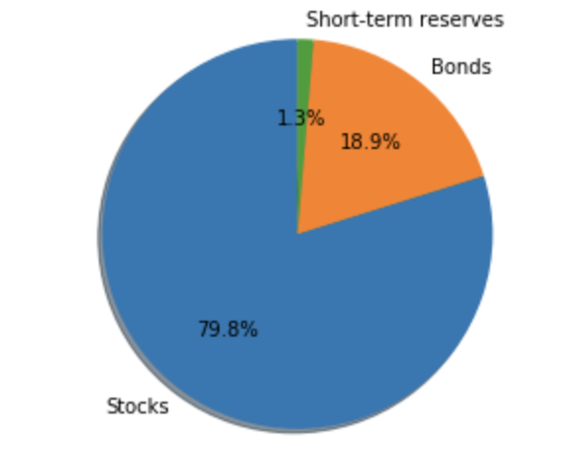
Vanguard 2040 Asset Allocation

Slide 11
The Code

Slide 12
Mutual Fund - Fidelity

Slide 13
Fidelity Freedom 2040 Fund (FFFFX)
Designed for investors who anticipate retiring in or within a few years of 2040 (target retirement date) at or around age 65.
The fund seeks high total return until its target retirement. Thereafter the fund’s objective will be to seek high current income and, as a secondary objective, capital appreciation.
The fund invests in U.S. Equity Funds, Bond Funds, International Equity Funds, and Short-Term Funds. The allocation changes from a higher weighting of 90% Equities (50% U.S. Equities, 40% International Equities) 10% Fixed Income (Bond & Short-Term Funds) from years 50 to ~ 20 years to retirement. As the closer to retirement age you obtain the allocation weighting changes from a heavy equity to a heavy fixed income investment strategy.
The fund has an annual operating expense of 0.75%, which is significantly higher than the Fidelity 500 Index Fund. This fund is meant for more longer term investment than traditional mutual funds.
Fidelity Freedom 2040 Fund Prospectus - https://fundresearch.fidelity.com/mutual-funds/summary/315792101

Slide 14
Fidelity 500 Index Fund (FXAIX)
Low cost mutual funds with annual operating expenses of 0.015%.
Fund pays transaction costs, such as commissions when the portfolio “turns over.”
The fund invests in 80% of common stock that are included in the S&P 500 Index. Lending securities to earn income for the fund.
Average Annual Returns are on par with the S&P 500 Index. Last year 18.5% vs 18.5%, Past 5 Years, 15.21% vs 15.22%.
Fidelity 500 Index Fund Prospectus - https://fundresearch.fidelity.com/mutual-funds/summary/315911750

Slide 15
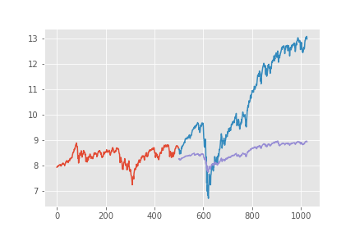
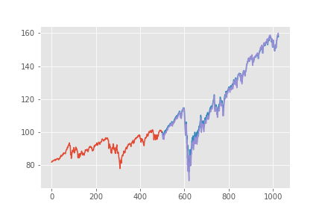
Fidelity Linear Regression Model
When running a linear regression model against historical prices for the Fidelity 500 Index & Fidelity 2040 Fund, the Fidelity 2040 has a closer correlation (graph on right) compared to the Fidelity 500 Index (graph on left)

Slide 16
Mutual Fund - T.Rowe

Slide 17
T.Rowe Price Funds
T.Rowe Price 2040 Fund (TRRDX)
Best for a person retiring between 2036 and 2040.
Conservitive investment
Set and forget type fund
Large cap Fund
Outperformed category average
32.02% return last year
14.22% return for past 3 years
T.Rowe Price 500 Fund (PREIX)
Tacks large stocks for S&P 500
Heavily invested in technology, financial services, and health care (Apple, J&J)
Expense ratio of .28 which is pricey
Better 10 years ago

Slide 18
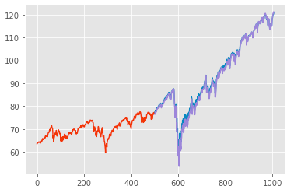
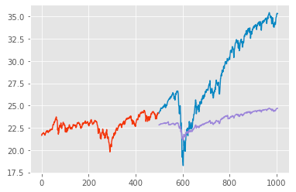
T.Rowe Price Linear Regression Models
T.Rowe Price 2040 Fund
T.Rowe Price 500 Fund

Slide 19
Mutual Fund - Schwab

Slide 20
Schwab
Benefits of investing in 2040 :
Reallocated based on a retirement date range (helping to meet investors retirement goals)
Competitively priced so your investment goes further
Combines active and passive proprietary and sub-advised / externally managed strategies
Net Expense Ratio: 0.640%
Benefits of S&P 500 :
A straightforward, low-cost fund with no investment minimum
The Fund can serve as part of the core of a diversified portfolio
Simple access to 500 leading U.S. companies and captures approximately 80% coverage of available U.S. market capitalization
Invests in some of the most well-known U.S. based companies
Net Expense Ratio: 0.020%
offers a great return over time, through tracking returns
Mutual Fund & The S&P 500 Comparison

Slide 21
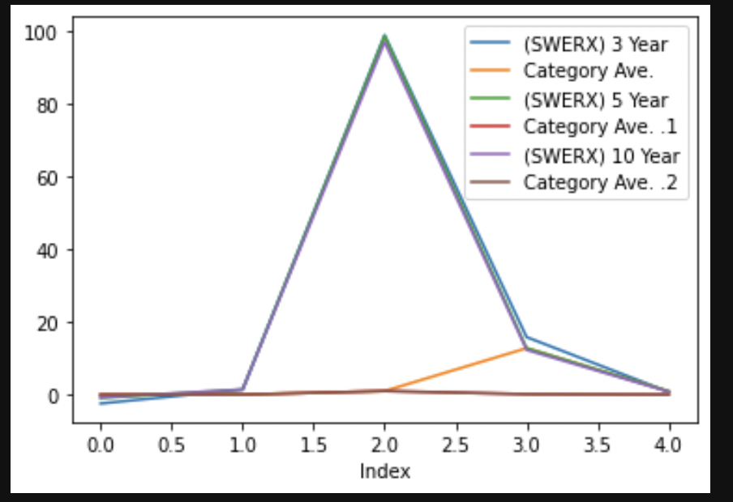
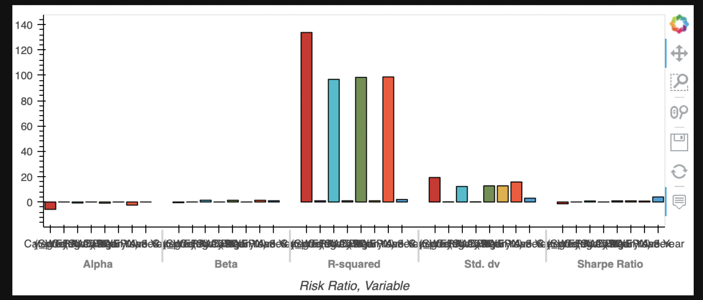
A Glance Of The Risk Ratios over the 3, 5, & 10 yr.
Schwab (SWERX) 2040

Slide 22
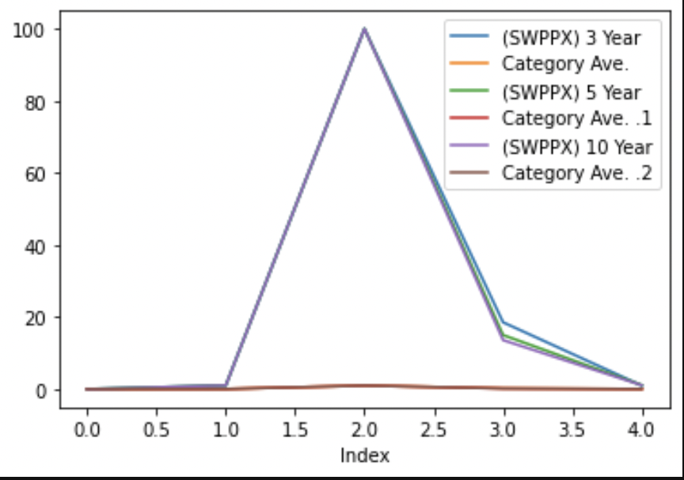
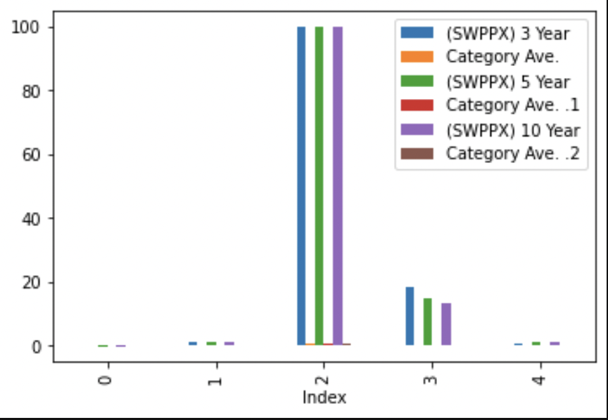
Schwab (SWPPX)
S&P 500

Slide 23
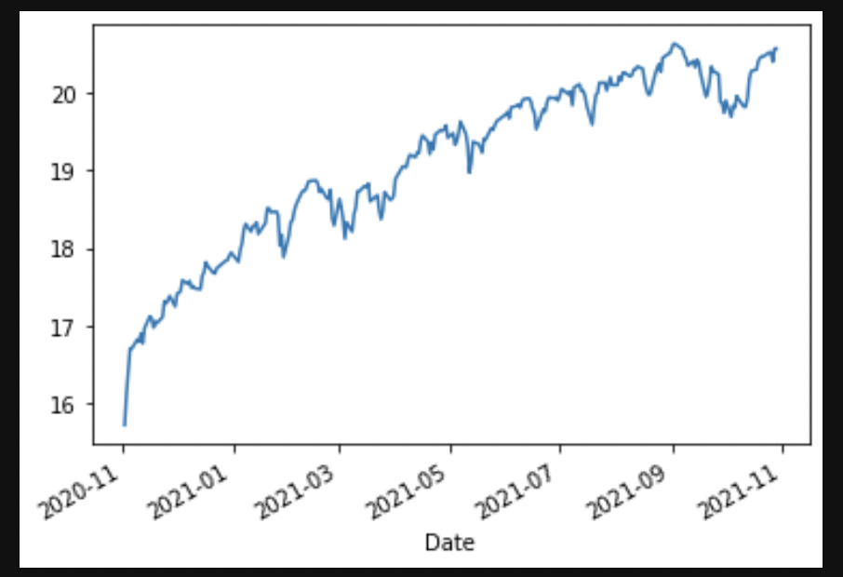
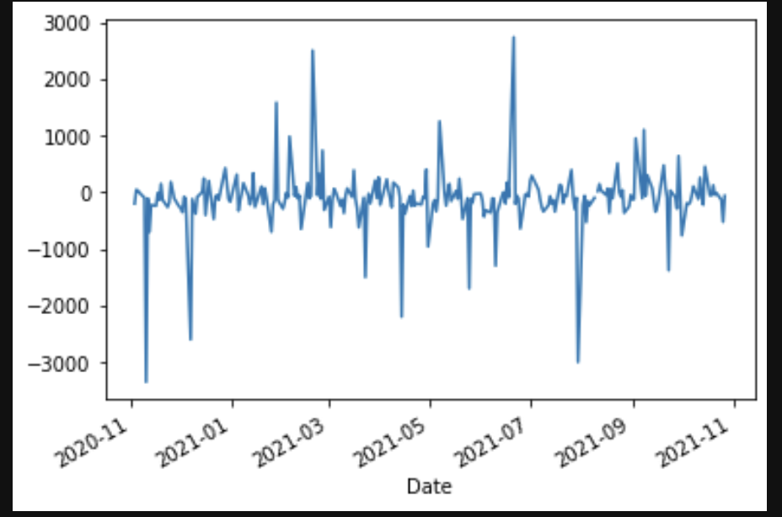
Schwab Historical Data : Linear Adjusted Closing Price
Schwab (SWPPX) S&P
Schwab (SWERX) 2040

Slide 24
Comparative Analysis

Slide 25
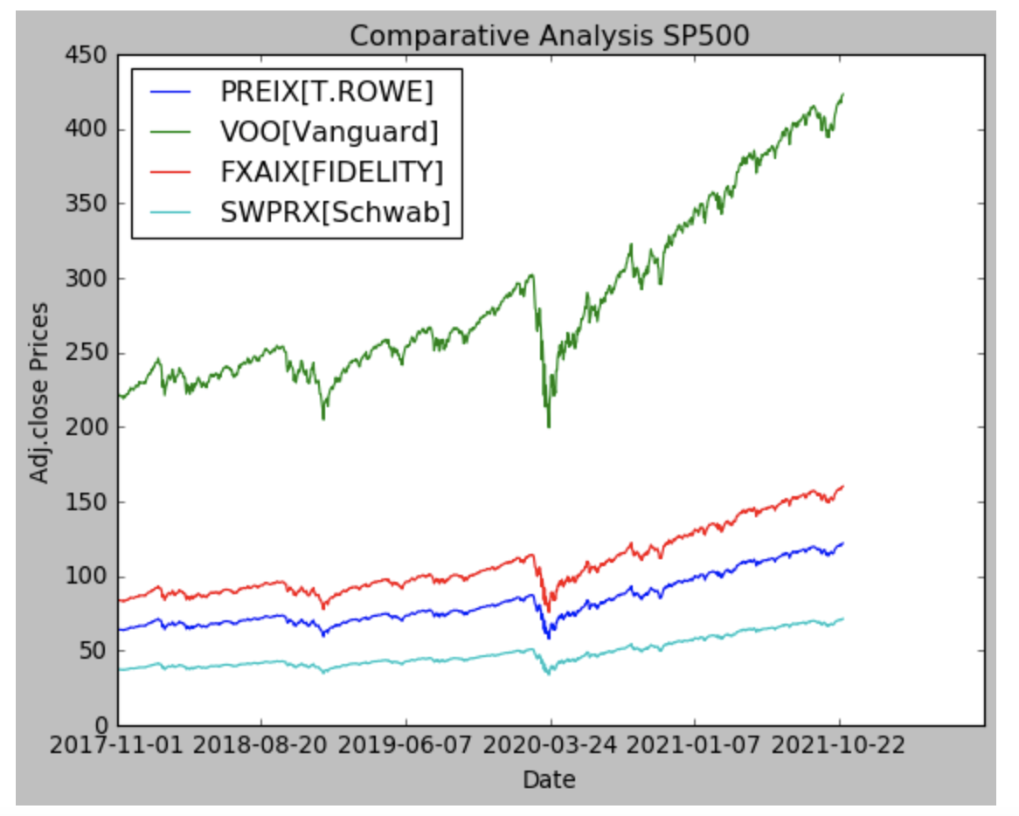
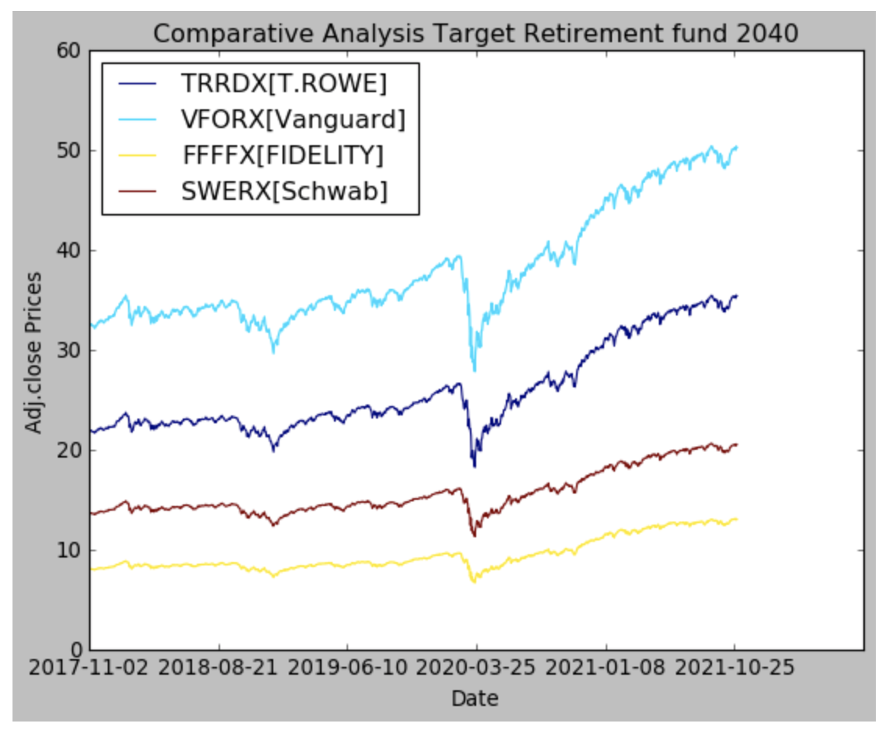
Comparative Analysis SP 500 & Target Retirement fund 2040

Slide 26
Cryptocurrency

Slide 27
Overview of Cryptocurrency Analysis
Conducted historical return and volatility analysis for following cryptocurrencies:
Bitcoin
Ethereum
Chainlink
Maker
Litecoin
Ripple
Historical return and volatility metrics based on last 1,000 trading days:
Cumulative returns
Annualized average return
Annualized standard deviation
Sharpe ratio
Sortino ratio
Beta
Estimated future growth for each cryptocurrency

Slide 28
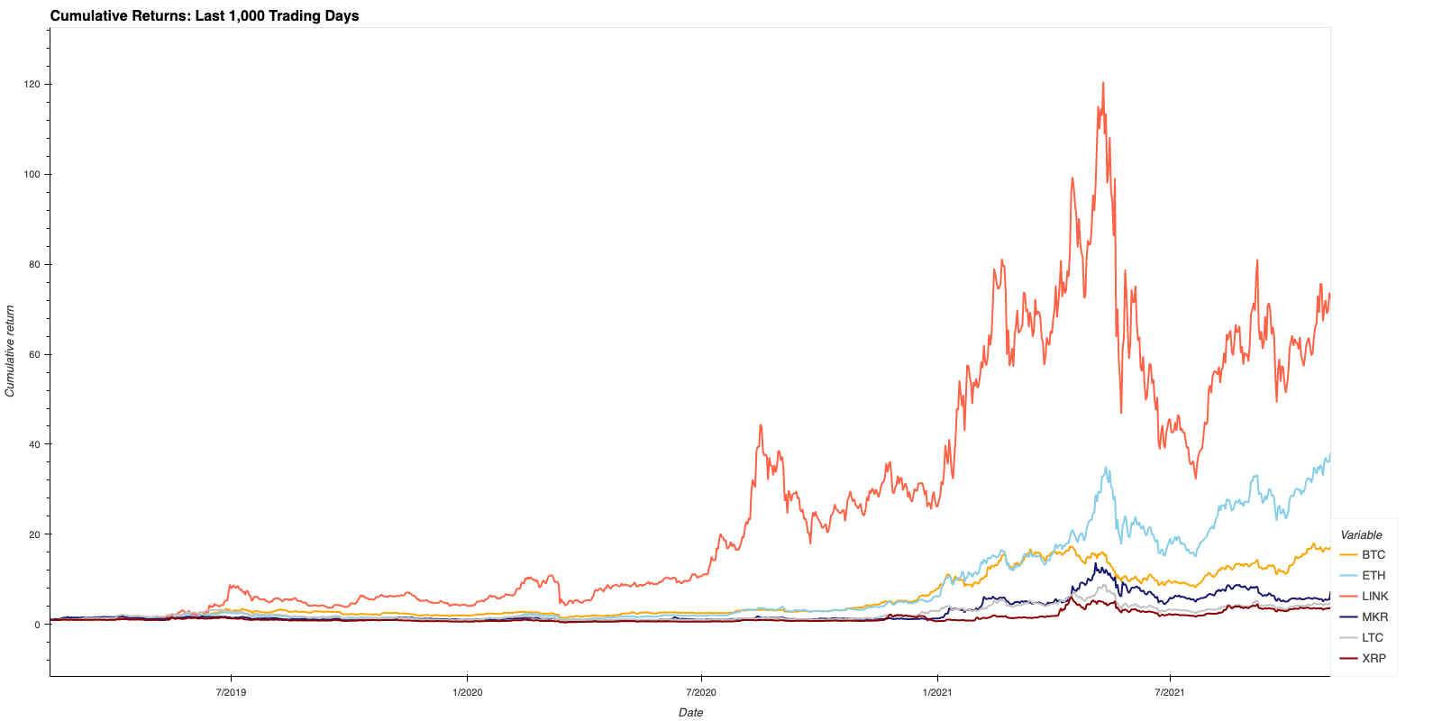
Cumulative Returns
LINK & ETH are strongest performers, with periods of explosive growth over the last 1,000 trading days
BTC produced moderate returns over the same timeframe
The rest of the assets in the analysis underperformed the market benchmark (BTC)

Slide 29
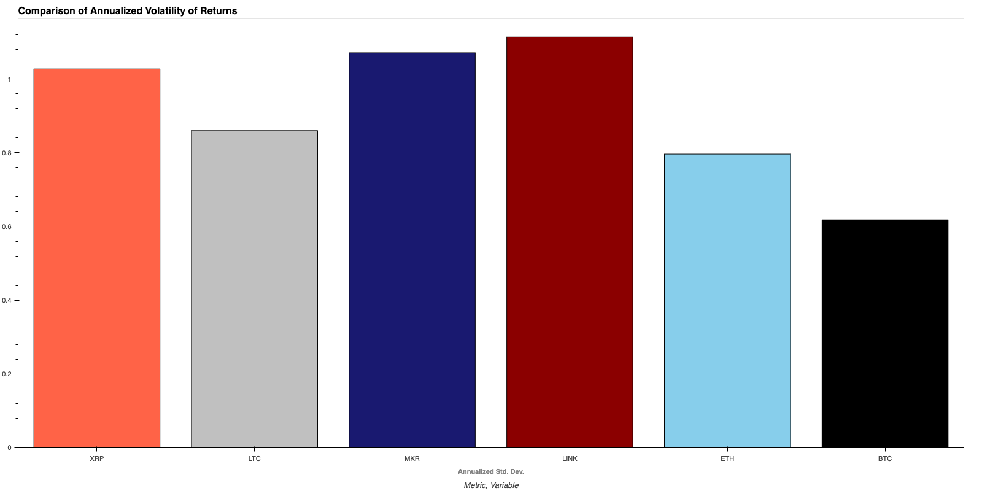
Comparison of Return Volatility
LINK, MKR, & XRP are most volatile assets in comparison
Unsurprisingly, BTC and ETH, the two leading crypto assets, appear to be the least volatile

Slide 30
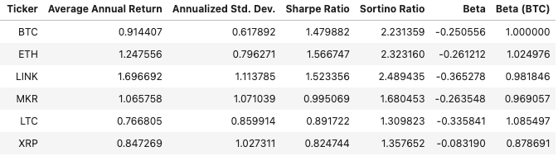
Metrics Summary Cryptocurrency

Slide 31
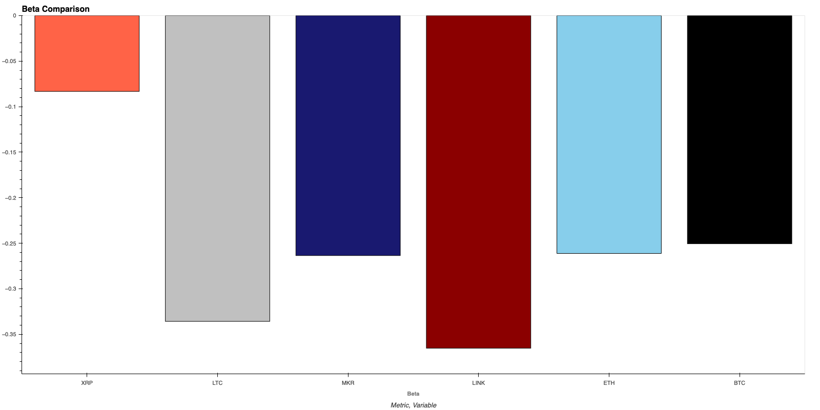
Beta Comparison (S&P 500)
All cryptocurrencies in comparison are inversely correlated with the broader market (S&P 500)
Suggests that cryptocurrencies could be used to hedge against serious market downturns (although the opposite is also possible)

Slide 32
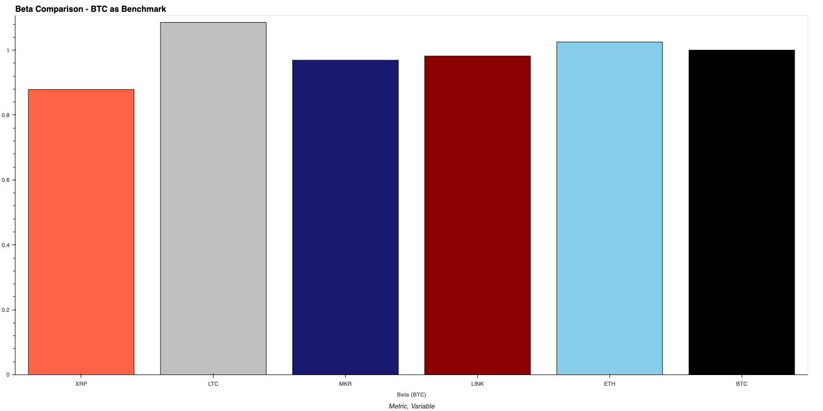
Beta Comparison (BTC)
All cryptocurrencies in comparison are positively correlated with the performance of BTC
This suggest that BTC is a general indicator of how crypto will perform in the market over time

Slide 33
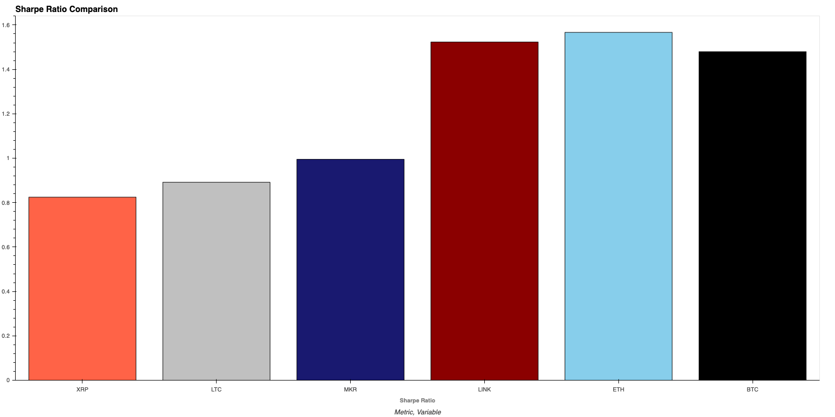
Sharpe Ratio Comparison
Based on our analysis, ETH, LINK, & BTC provide the best risk-adjusted returns in the comparison
With Sharpe ratios under 1, LTC & XRP stand out as the least desirable investments

Slide 34
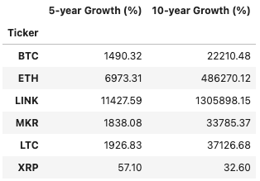
Forecast Summary Cryptocurrency

Slide 35
Appendix

Slide 36
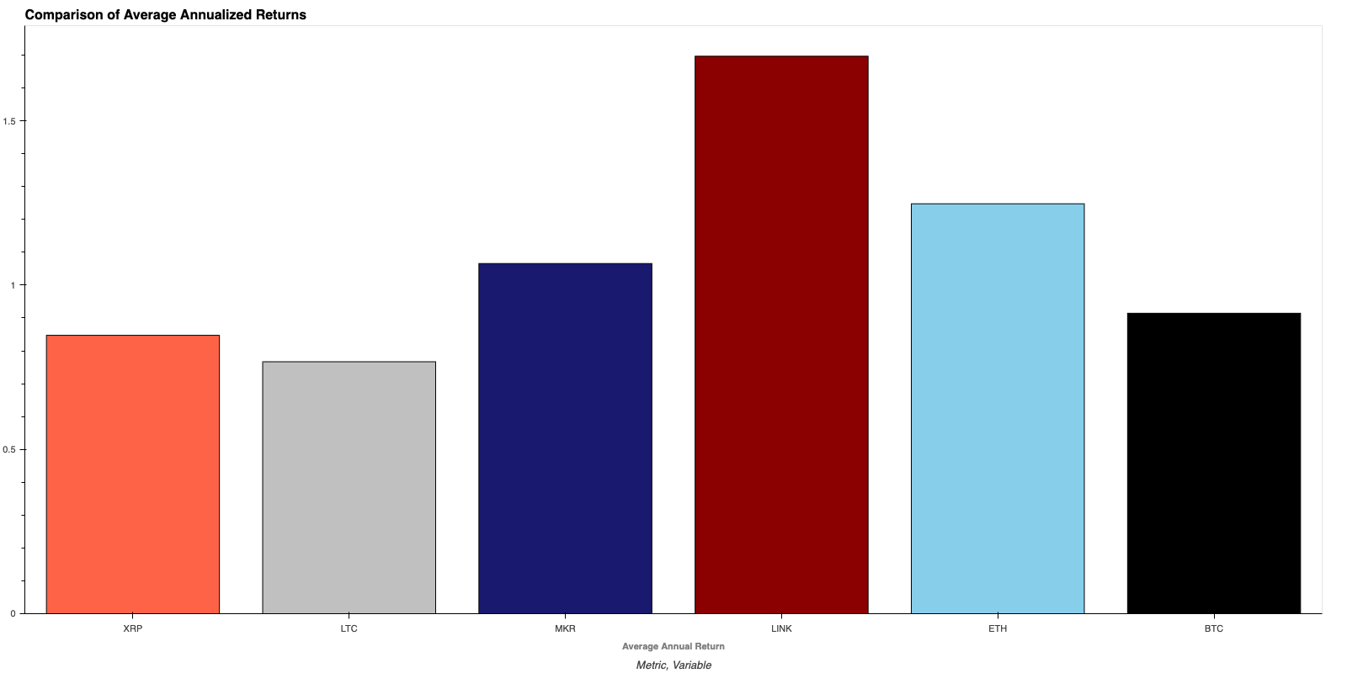
Annualized Returns
LINK (~170%), ETH (~125%), & MKR (~106% )all produce annualized average returns in excess of 100%
Once again, XRP & LTC post the lowest returns in the comparison and underperform BTC (~91%)

Slide 37
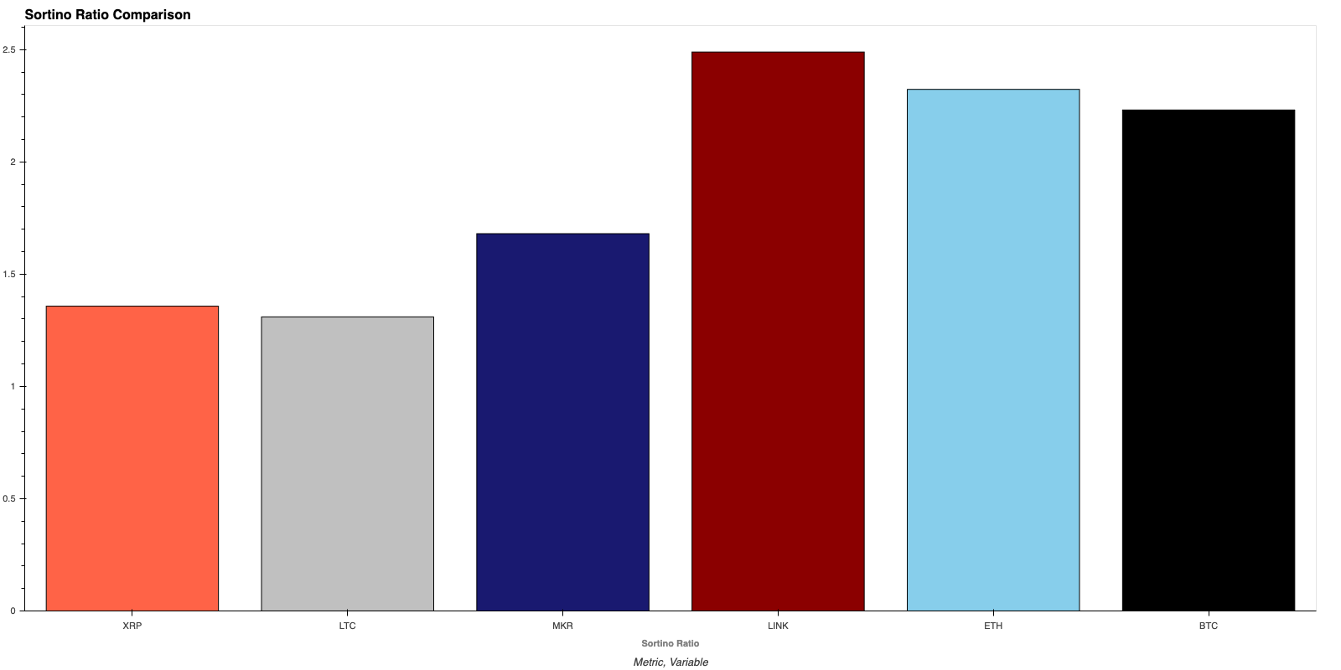
Sortino Ratio Comparison
After adjusting for just downside risk, LINK, ETH, & BTC still clearly provide the best returns
With Sortino ratios under 2, MKR, LTC, and XRP do not sufficiently compensate investors for potential risk

Slide 38
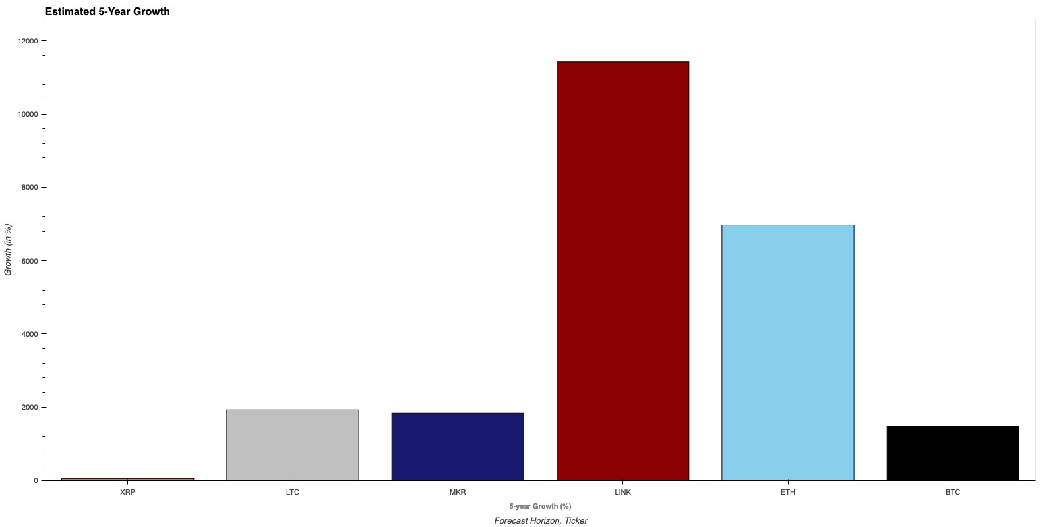
Estimated 5-Year Growth
LINK & ETH have the strongest 5-year growth rate of about 11,000% and 7,000% respectively
Ripple (XRP) has the lowest projected 5-year growth at 57%

Slide 39
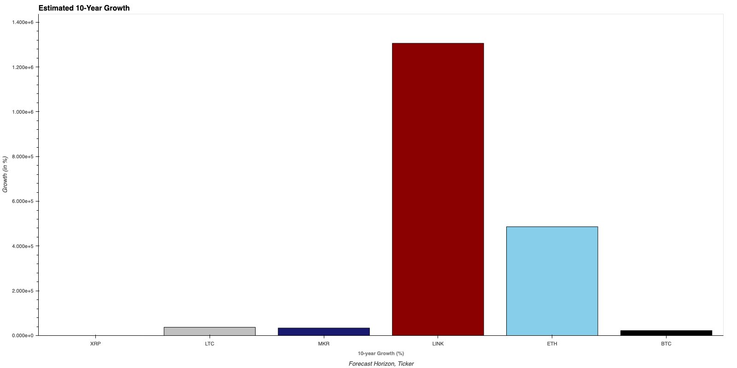
Estimated 10-Year Growth
LINK & ETH have the strongest 10-year growth rate of about 1,300,000% and 486,000% respectively
Ripple (XRP) has the lowest projected 10-year growth at 32%

